Slide 1
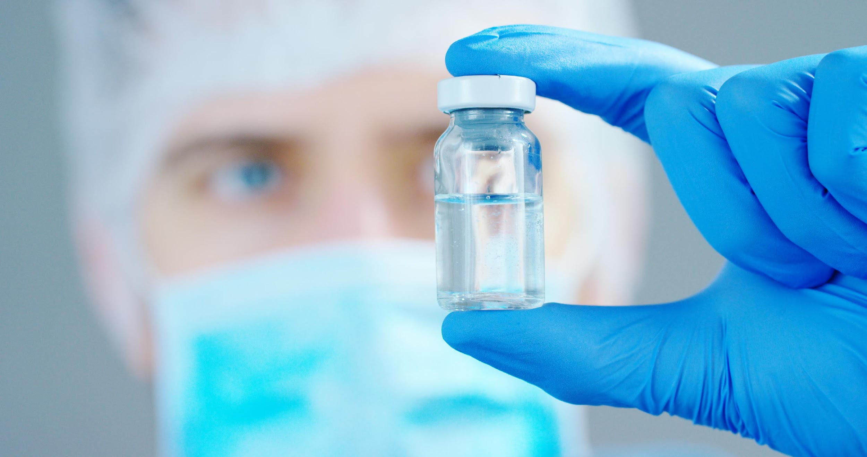
AuRx Theracine:
THE CURE FOR CANCER AND THE WORLD’S
MOST FAMOUS “INCURABLE” DISEASE

Slide 2

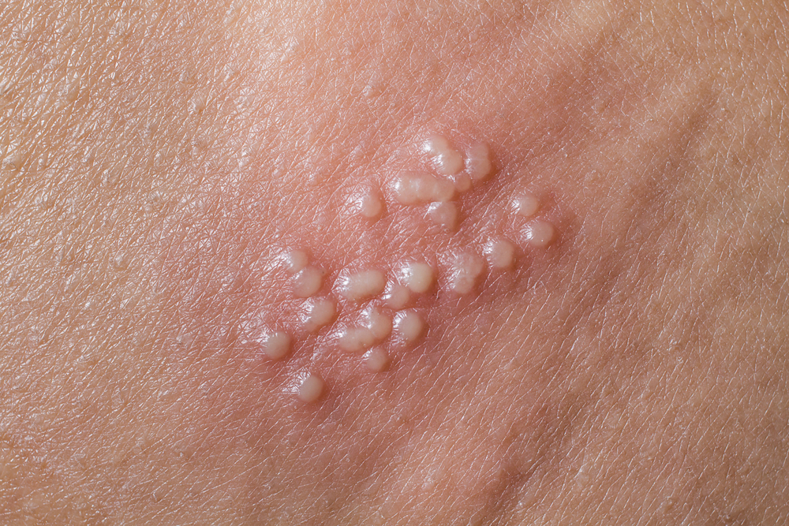
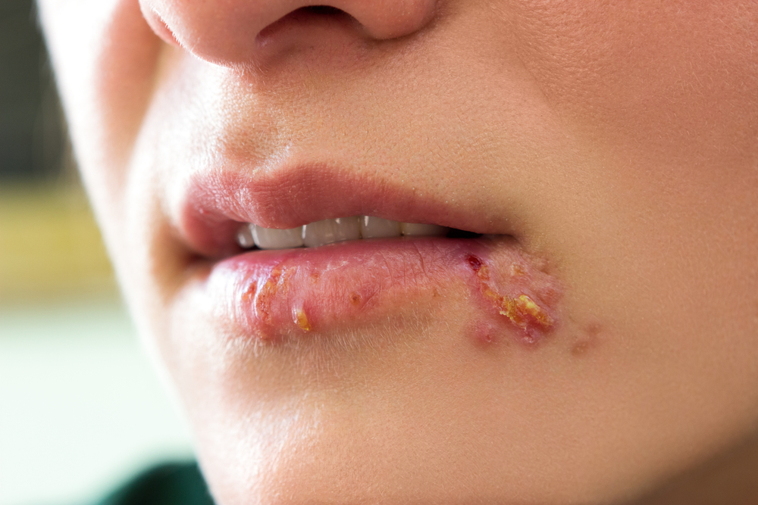
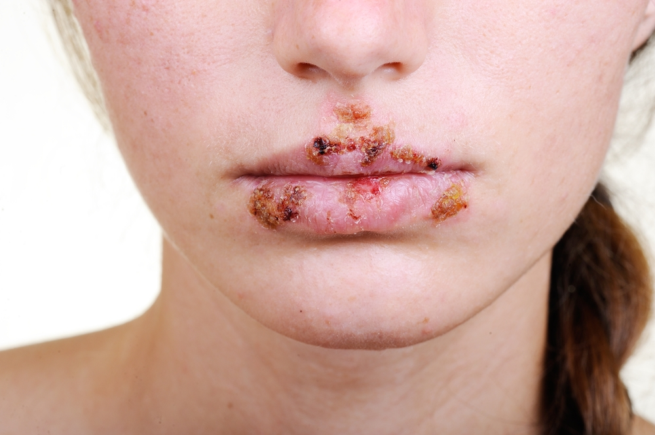
The Herpes market is currently $4.8B, for wholly ineffective treatments that do nothing more than address symptoms, slightly reducing the frequency and duration of the current outbreak.
Herpes sufferers on current treatments still experience:
  Itching
  Pus-filled cysts
  Burning
  Open ulcers
  Pain with urination
Facial and genital symptoms can last up to four weeks per episode. Since episodes range from 0 to 28 per year, some patients experience symptoms continuously. The market size continues to grow as young people reach the age of sexuality and become infected. Due to increased exposure surface area, the pool of women is larger, increasing the likelihood of being treated.

Slide 3
THE PROBLEM
THE SOLUTION
WITH HERPES TREATMENTS
AURX THERACINE
Because the Herpes virus masks itself in the human body, the body does not create the required antibodies to eradicate the disease.
Transmission can occur even when symptoms are suppressed by current treatments.
Herpes lesions create a pathway for the spread of other blood born and sexually transmitted diseases, especially HIV.
AuRx’s Theracine is a live, recombinant virus that eliminates the portion of the virus that masks itself as human.
Introduction of Theracine, in as few as 2 injections, teaches the body to create an immune response to the Herpes virus.
The body ultimately creates a powerful enough immune response to the virus to completely eliminate it and protect against reinfection.

Slide 4
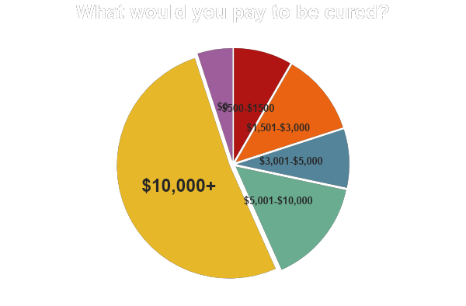
Current Value
BASED ON NEGATIVE IMPLICATION
In a recent survey by Honeycomb, a leading herpes website, the leading online Herpes forum, participants were asked what monetary value they would attach to a cure. While 43.3% attributed a value of between $500 -$10,000, over HALF of surveyed subjects were willing to pay upwards of $10,000 for a permanent remedy or prevention.

Slide 5
Global Estimates
OF PREVALENT AND INCIDENT HSV-2 INFECTIONS*
EUROPE
USA
67M Infected 72M Infected 8.9M Infected
JAPAN

Slide 6
AuRx Represents The Future of Herpes Care
CURRENT:
FUTURE:
ACYCLOVIR
AURX THERACINE
Acyclovir, an antiviral drug, merely slows the growth and spread of the herpes virus in the body.
Current treatment eradicates neither signs nor symptoms of herpes.
Must be taken daily and/or with each recurrence or episode.
AuRx Theracine results in a drastic reduction in both episodes and symptoms.
In some test subjects, AuRx represents eradication – the ultimate CURE.
Administered via a limited, one-time series of injections. Repeated treatment may improve results in duration of effect.

Slide 7

The HSV-1 (Cold Sore) Cure- Research Opportunity
160-260 M Americans have HSV-1, presently incurable. 369M persons in Europe/Japan are infected.
Market size continues to grow due to how easily the disease spreads, passed when infected mothers kiss their children while shedding the virus at the start of an outbreak.
As with HSV-2, current therapeutics are wholly ineffective, reducing symptoms by only 30% and required daily, with outbreaks occurring from single missed doses.
This market will be available once AuRx has data from the HSV-2 treatment study showing effectiveness on HSV-1 recurrences in HSV-2 infected patients.

