Slide 1

AuRx Theracine:
THE CURE FOR CANCER AND THE WORLD’S
MOST FAMOUS “INCURABLE” DISEASE

Slide 2
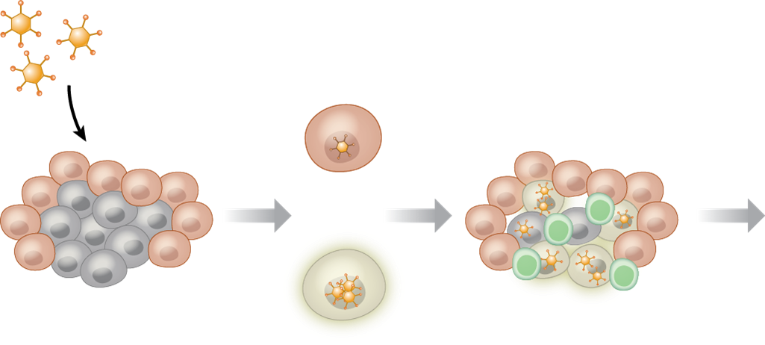
Oncolytic Viruses present a new type of “targeted” cancer therapy
    Unfortunately, the majority of OVs have limited clinical efficacy as a single agent since the antiviral immune response can prevent the virus from reaching the tumor tissue and having a therapeutic effect.¹
    However, there is no natural immunity to herpes simplex virus, thus, ΔPK is not affected by the body’s immune response. ^{2,3}
No ΔPK
replication in normal cells
ΔPK stimulates immune cell attack
ΔPK
Treatment is a success!
Normal cell
ΔPK spreads from one tumor cell to another tumor cell with virus replication and penetration
Tumor cell
ΔPK replicates
and the cell dies
Notes:
1 Oncotarget. 2017 Nov 24; 8(60): 102617–102639. Review: Oncolytic virotherapy, updates and future directions Christos Fountzilas, Sukeshi Patel, and Devalingam Mahalingam https://www.ncbi.nlm.nih.gov/pmc/articles/PMC5731986/pdf/oncotarget-08-102617.pdf
2 DPK oncolytic activity includes modulation of the tumour cell milieu. Dominique Bollino, Aric Colunga, Baiquan Li and Laure Aurelian J Gen Virology (2016), 97, 496–508, Fig 1c.
3 The oncolytic virus ΔPK has multimodal anti-tumor activity. Aurelian L, Bollino D, Colunga A. Pathog Dis. 2016 Jul;74(5).

Slide 3
Yearly Global Estimates of Cancer
USA
Breast
invasive 266,120
CIS 63,960
Brain 23,880
Ovarian 21,000
Melanoma 9,127
EUROPE
Breast
invasive /cis 404,920
Brain 27,000
Ovarian 65,000
Melanoma 104,000
JAPAN
Breast
invasive /cis 86,500
Brain 5,000
Ovarian 10,600
Melanoma 29,400
Notes:
Japan GANJOHL.jp/en/public/statistics

Slide 4
THE PROBLEM
THE SOLUTION
WITH CANCER TREATMENTS
AURX THERACINE
Chemotherapy does not fully kill the cancer and cancer stem cells which results in recurrence. One drug will not effectively wipe out some cancers.
Chemotherapy, radiation, and monoclonal antibodies do not kill the cause of metastasis – cancer stem cells.
Side effects of current treatments are nearly as bad as the disease.
AuRx’s Theracine is a live, recombinant virus that wipes out both the cancer and the cells that spread the tumor to other places in the body.
Introduction of Theracine, in as few as 1-4 injections, completely eradicates tumors and metastatic agents.
The body ultimately creates a powerful enough immune response to the tumor to completely eliminate it and protect against distant recurrences.

Slide 5


Cancer Treatment – the old way – Chemotherapy – 1960 –1980’s
Side Effects
Hair loss
Chemo brain/
brain fog
Anxiety and depression
Cells most commonly affected by chemotherapy:
Blood cells – low blood cell counts
Digestive cells – mouth sores, stomach and bowel distress – nausea, diarrhea
Hair follicle cells – hair loss.
Tumor cells usually evade total killing resulting in regrowth or metastasis.
Mouth sores
Weak heart
Stomach and bowel distress
Bone density loss

Slide 6
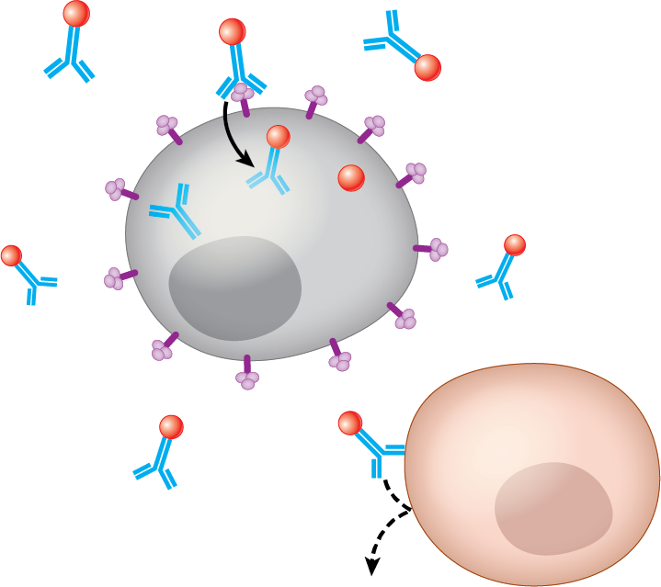
A Newer Way: Targeted Cancer Therapy 1980’s - Present
Cancer
drug
Monoclonal antibody
Monoclonal antibodies
Normally, the body creates antibodies in response to an antigen (such as a protein in a germ) entering the body.
The antibodies attach to the antigen in order to mark the antigen for destruction by the body's immune system.
Specific proteins (targets) on the surface of cancer cells are matched with specific monoclonal antibodies and the result is destruction of the tumor cell.
This only works if the tumor cell has the specific target specified by the monoclonal antibody.
Protein target on cancer cell
Cancer
cell
Normal cell
Monoclonal antibody will not bind to a normal cell without a protein target
Notes:
Herceptin (sales $7.4 B), Opdivo ($6.4B), Keytruda ($6.6B) and Yervoy ($1.2B) are examples

Slide 7
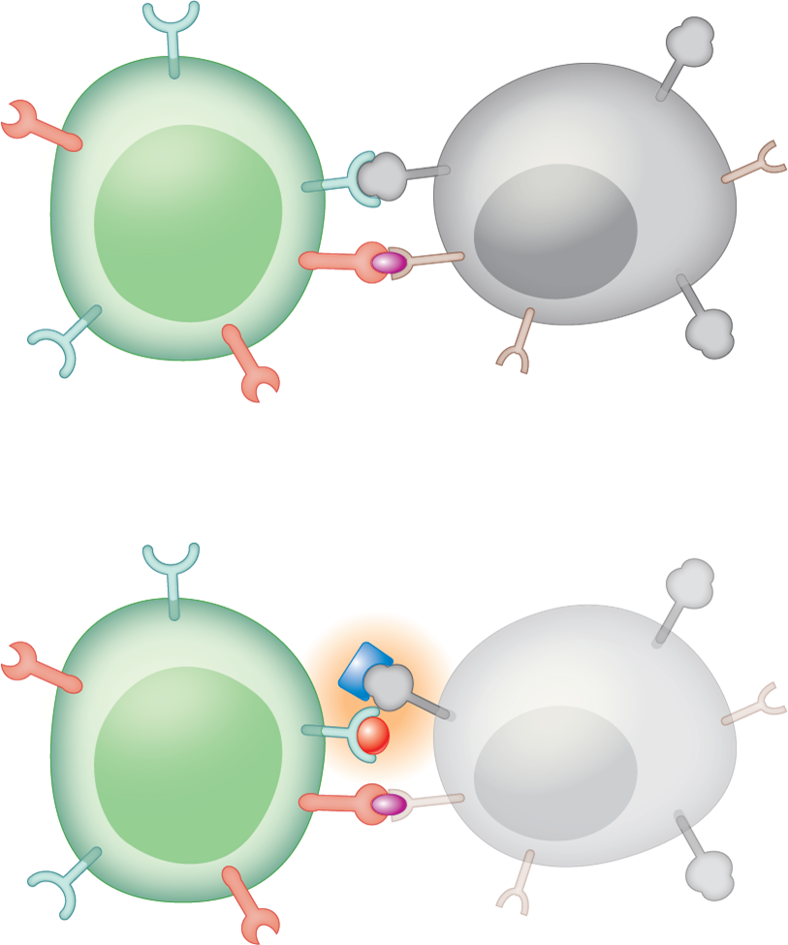
Targeted Cancer Therapy Immune system modifiers
PD-1 binds to PD-L1 and inhibits the T cell from killing the tumor cell
PD-1
PD-L1
    Technology that uses monoclonal antibodies to target specific immune responses:
    Causes less toxicity to healthy cells
    Checkpoint proteins, such as PD-L1 on tumor cells and PD-1 on T cells, help prevent immune responses from destroying normal cells
    The binding of PD-L1 to PD-1 prevents T cells from killing tumor cells in the body
Blocking the binding of PD-L1 to PD-1 with an immune checkpoint inhibitor allows the T cells to specifically kill tumor cells
T cell
Tumor cell
T cell receptor
Antigen
Immune checkpoint inhibitors block PD-L1 and PD-1 from binding
Immune checkpoint inhibitors
T cell is able to kill tumor cell
Tumor cell dies
Notes:
Examples of checkpoint modifiers -- Keytruda ($6.6B), Opdivo ($6.4B) Yervoy ($1.2B)
Yervoy’s label carries a black-box warning for potentially severe and fatal immune toxicities that can include any organ system, but most commonly include enterocolitis, hepatitis, dermatitis, neuropathy and endocrinopathy.

Slide 8
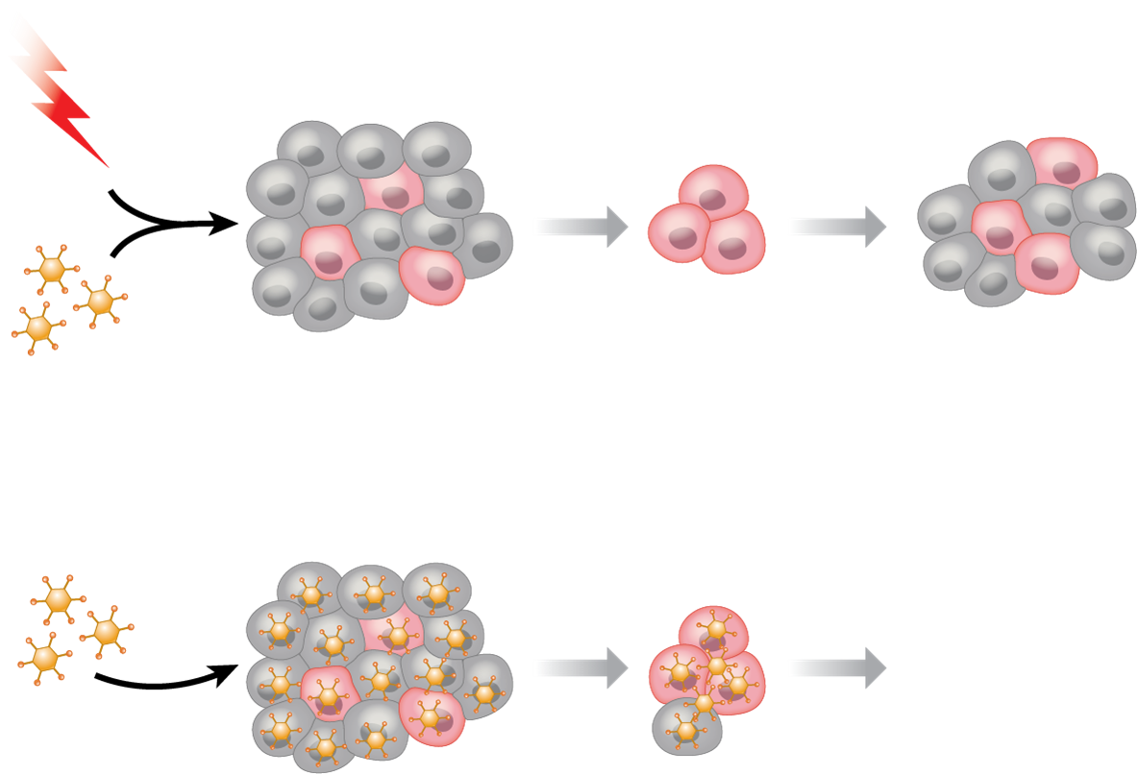
The AuRx Theracine (ΔPK) kills cancer stem cells
    ΔPK effectively penetrates breast cancer tumor cell cultures even when given at very low levels and it destroys even the cancer stem cells (which cause metastasis).
Tumor regression
Chemotherapy
Radiation therapy
Tumor regression
Tumor recurrence
OVs
Cancer
stem cell
Tumor regression
ΔPK
Tumor eradication

Slide 9
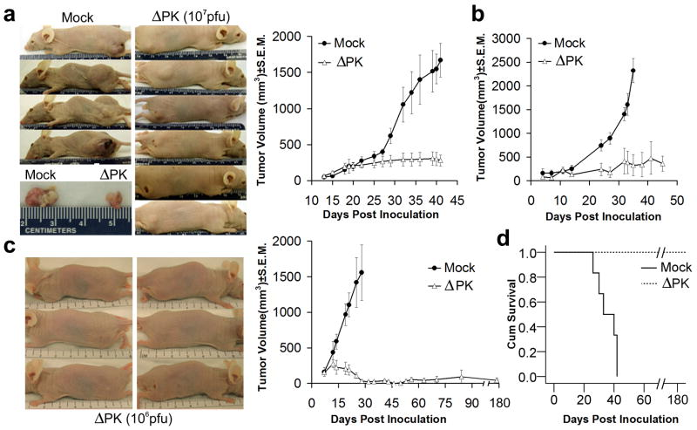
ΔPK inhibits the growth of melanoma xenografts
From: Colunga, et al The HSV-2 mutant delta pk induces melanoma oncolysis…. Gene Ther, 2010 17, 315
Notes:
Notice that in d, no adverse effect of deltaPK was seen in any of the mice receiving it – indicating that deltaPK does not replicate in normal tissue, but does do so in tumor cells.
“Collectively, the data indicate that ΔPK has selective growth in transformed/tumor cells.
ΔPK-induced melanoma oncolysis includes a robust component other than virus replication” p.3. author manuscript, p. 316 of published manuscript
From: Colunga, et al The HSV-2 mutant delta pk induces melanoma oncolysis…. Gene Ther, 2010 17, 315

Slide 10
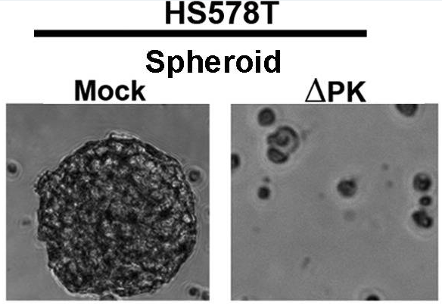
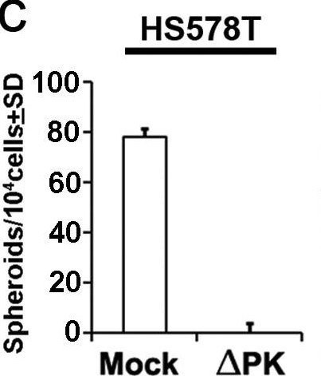
Effectiveness of ΔPK in killing breast cancer stem cells
Effectively targets the breast cancer stem cells that cause the growth of cancer
ΔPK effectively penetrated 3D spheroid cultures (tumor like structures) even when given at the very low level of 0.1 pfu/cell and it destroyed all cells by 4 cycles of treatment
Notes:
From: Colunga, et al The HSV-2 mutant delta pk induces melanoma oncolysis…. Gene Ther, 2010 17, 315

